Slide 1










PRESENTED BY
T. BHUVANESHWARAN-511320104011
N. DHANUSH-511320104017
R. GOWTHAM-511320104023
E. HUBERT RYAN-511320104026

Slide 2
OBJECTIVE:
The primary objective of implementing deep fake detection using Convolutional Neural Networks (CNNs) in Python is to create a sophisticated system capable of disceving between authentic and manipulated media content.
This entails developing a discriminate neural network trained on diverse datasets encompassing various deep fake scenarios. The system integrates advanced techniques to analyze artifacts inherent to CNN-generated content, such as unique noise patters.

Slide 3

ABST CT:
In this project, we embark on the development of an advanced deep fake
detection system leveraging Convolutional Neural Networks (CNNs)within programming environment.
The central focus is on creating a neural network that can effectively discev
between genuine and artificially generated media content. To achieve this,
the system undergoes extensive training on diverse datasets, enabling it to
recognize subtle nuances and artifacts specific to CNN-generated content.
Our approach involves the integration of sophisticated analysis techniques,
including the examination of unique noise patterns and inconsistencies in
facial expressions inherent to deep fake media.
The system benefits from pre-trained models for facial recognition,
enhancing its ability to extract key features and improve overall accuracy.

Slide 4
INTRODUCTION:
The advent of Convolutional Neural Networks (CNNs) has ushered in a new era of media manipulation, with deep fake technology posing a formidable challenge to the authenticity of digital content. Deep fakes, or artificially generated media, often blur the line between reality and fabrication, making it imperative to develop robust detection mechanisms to safeguard against malicious uses. In this context, our project focuses on creating a state-of-the-art deep fake detection system using CNNs within the Python programming environment.
Our project seeks to address this gap by harnessing the power of CNNs, a class of neural networks known for their ability to generate realistic content.By employing a discriminative neural network trained on diverse datasets, our system aims to excel in distinguishing between authentic and deep fake media.

Slide 5
EXISTING SYSTEM:
Image forensics techniques involved analyzing metadata, such as timestamps, camera information, and compression details, to identify irregularities associated with deep fake creation.
Facial recognition algorithms were employed to compare facial features in images or videos against known datasets to verify the identity of individuals.
Audio Analysis
Behavioral Analysis.
Manual Verification.

Slide 6
DISADVANTAGES:
Limited Accuracy
Inability to Detect Subtle Manipulations.
Vulnerability to Advanced Techniques.
Lack of Adaptability.
Difficulty in Handling Multi-Modal Deepfakes.

Slide 7
PROPOSED SYSTEM:
The proposed system of CNN-based Deep fake Detection introduces a novel approach to enhance the accuracy and efficiency of deep fake detection methods. Leveraging Convolutional Neural Networks (CNNs), the system aims to address the limitations of traditional techniques and provide a more robust solution. The system incorporates adaptive leaving techniques, enabling it to continuously evolve and stay ahead of emerging deep fake generation Ensemble Techniques methods.

Slide 8
Literature survey :
“DeepFakes: A New Threat to Face Recognition?” by Andreas Rossler, Davide Cozzolino, Luisa Verdoliva, Christian Riess, Justus Thies, Matthias Nießner. (2019)
This paper investigates the impact of deepfake videos on face recognition systems. It discusses the effectiveness of various deep learning-based methods in detecting deepfakes.
“Deep Learning for Deepfakes Creation and Detection” by Yuezun Li, Xin Yang, Pu Sun, Honggang Qi, Siwei Lyu. (2020)
This paper provides a comprehensive review of deep learning techniques for both creating and detecting deepfakes. It covers various generative models used for deepfake synthesis and discusses state-of-the-art detection methods.

Slide 9
Modules :
Input Module:
This module is responsible for collecting and preprocessing the multimedia data, which may include images, videos, or audio files, to be analyzed for the presence of deep fakes. It involves tasks such as data acquisition from various sources, data cleaning, and possibly data augmentation to enhance the diversity of the dataset

Slide 10
Feature Extracfion Module:
In this module, deep leaving techniques are applied to extract relevant features from the input data. This could involve using pre-trained Convolutional neural networks (CNNs) to automatically leav and extract features that are indicative of deep fake manipulation. Feature extraction aims to transform raw data
into a high-dimensional representation that captures discrimination
patters.

Slide 11
Model Training Module:
The model training module involves training deep leaving models, such as CNNs or recuaent neural networks (RNNs), on the extracted features to leave to distinguish between authentic and manipulated content. This phase includes tasks such as model selection, hyperparameter tuning, and training on labeled datasets containing both real and deepfake samples.

Slide 12
Detection Module:
Once the models are trained, the detection module applies them to new, unseen data to identify instances of deep fakes. This module utilizes the leaved representations to classify whether a given piece of multimedia content is authentic or manipulated. Depending on the specific approach, the detection module may involve thresholding, ensemble methods, or post-processing techniques to refine the detection results.

Slide 13
lntegration Module:
The integration module integrates the various components of the deep fake detection system into a cohesive framework. It ensures seamless communication between modules and may involve deploying the system in
real-world settings, such as integrating with video
surveillance systems or online platforms, to detect and
mitigate the spread of deepfakes.

Slide 14
Discrimination Module :
The use of deep learning techniques for detecting deep fakes raises concerns regarding potential discrimination, particularly in the context of biased training data or algorithmic biases.
Discrimination may occur if the training dataset disproportionately represents certain demographic groups or lacks diversity, leading to biased models that perform poorly on underrepresented populations.Strategies such as collecting representative and diverse training data, implementing fairness-aware learning algorithms, and ensuring transparency and accountability in model development and deployment can help mitigate discriminatory outcomes and promote fairness in deep fake detection efforts.

Slide 15
ADVANTAGES:
Ensemble Techniques.
Adversarial Training.
Complex Pattev Leaving.
Realistic Forgery Generation.
Enhanced Generalization.
Dynamic Adaptation.

Slide 16

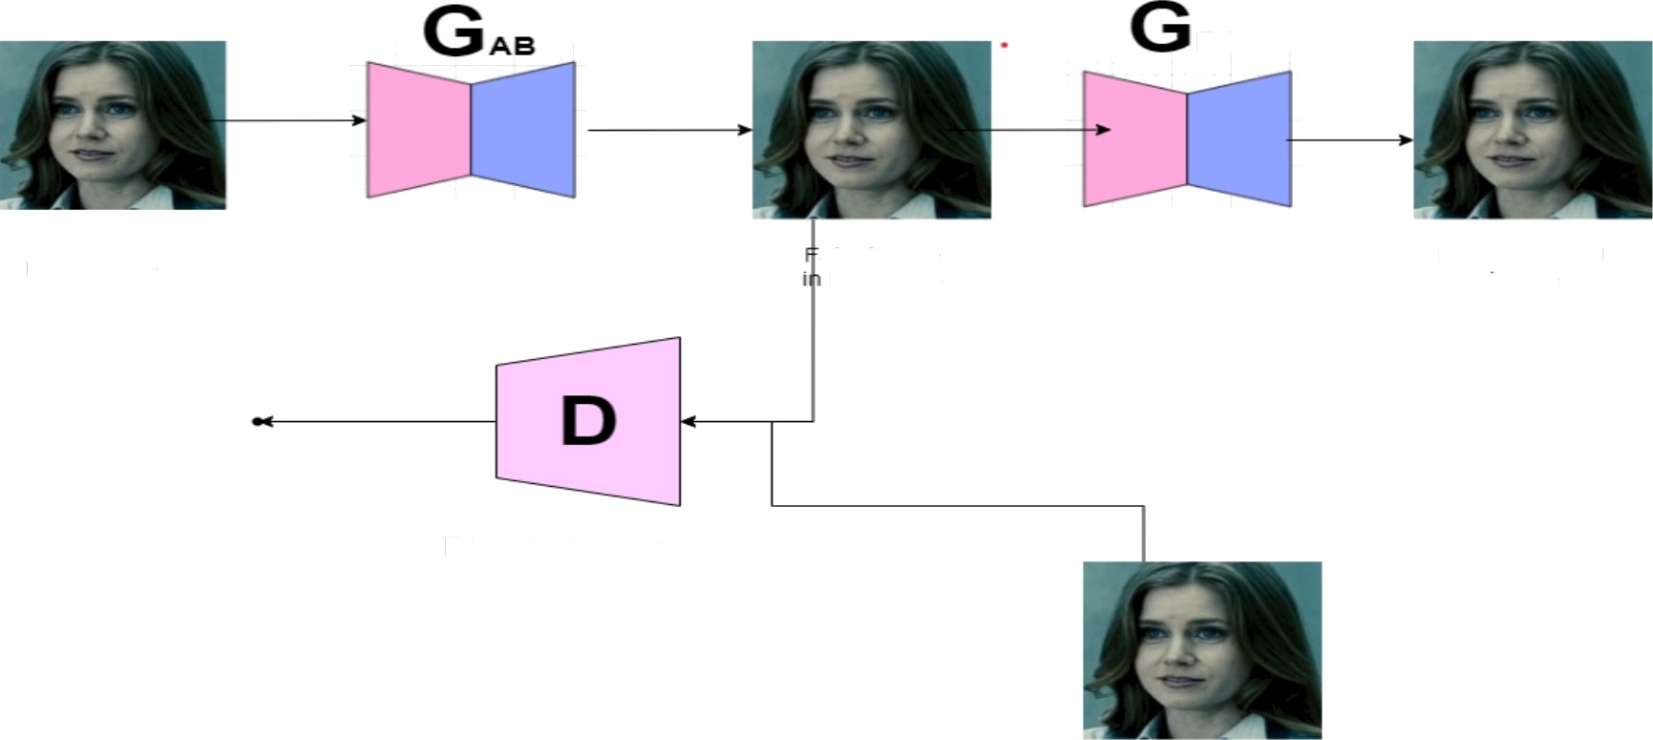
BLOCK DIAG
tear image
in Domain A
aKe mag e
TO main H
Reconstructed irnage
tear iGuage

Slide 17
Use case diagram

Slide 18


SOFTWA
REQUI
MENTS:
PYTHON IDLE: 3.12.0
PIP (PYTHON PACKAGE INSTALLER)
ANACONDA NAVIGATOR
OPERATING SYSTEM: WINDOWS 10 or ABOVE (64 bit )
PYCHARM or VSCODE

Slide 19
HARDWARE REQUIREMENTS:
HDD: 256GB or above
PROCESSOR: i5 or above
RAM:8GB or above

Slide 20
CONCLUSION:
The utilization of Convolutional Neural Networks (CNNs)in deep fake detection marks a substantial advancement in combating the proliferation of deceptive multimedia content.
CNNs operate on an adversarial training framework, creating a formidable challenge for deep fake generators, thereby heightening the difficulty of producing convincing forgeries. This approach significantly enhances the detection capabilities of algorithms, enabling them to identify subtle manipulations and artifacts associated with deep fake content.

Slide 21
REFERENCES:
[1] C. Navarro et al., “A point-of-care measurement of NT-proBNP for heart failure patents,” IEEE Access, vol. 8, pp. 138973 138983, 2020.
[2] K. H. Foysal, S. E. Seo, M. J. Kim, O. S. Kwon, and J. W. Chong, “Analyte quanñty detecñon from lateral flow assay using a smartphone,” Sensors, vol. 19, no. 21, p. 4812, Nov. 2019.
[3] Global Status Report on Noncommunicable Diseases 2014, World Health Org., Geneva, Switzerland, 2014.

